Slide 1


Slide 2
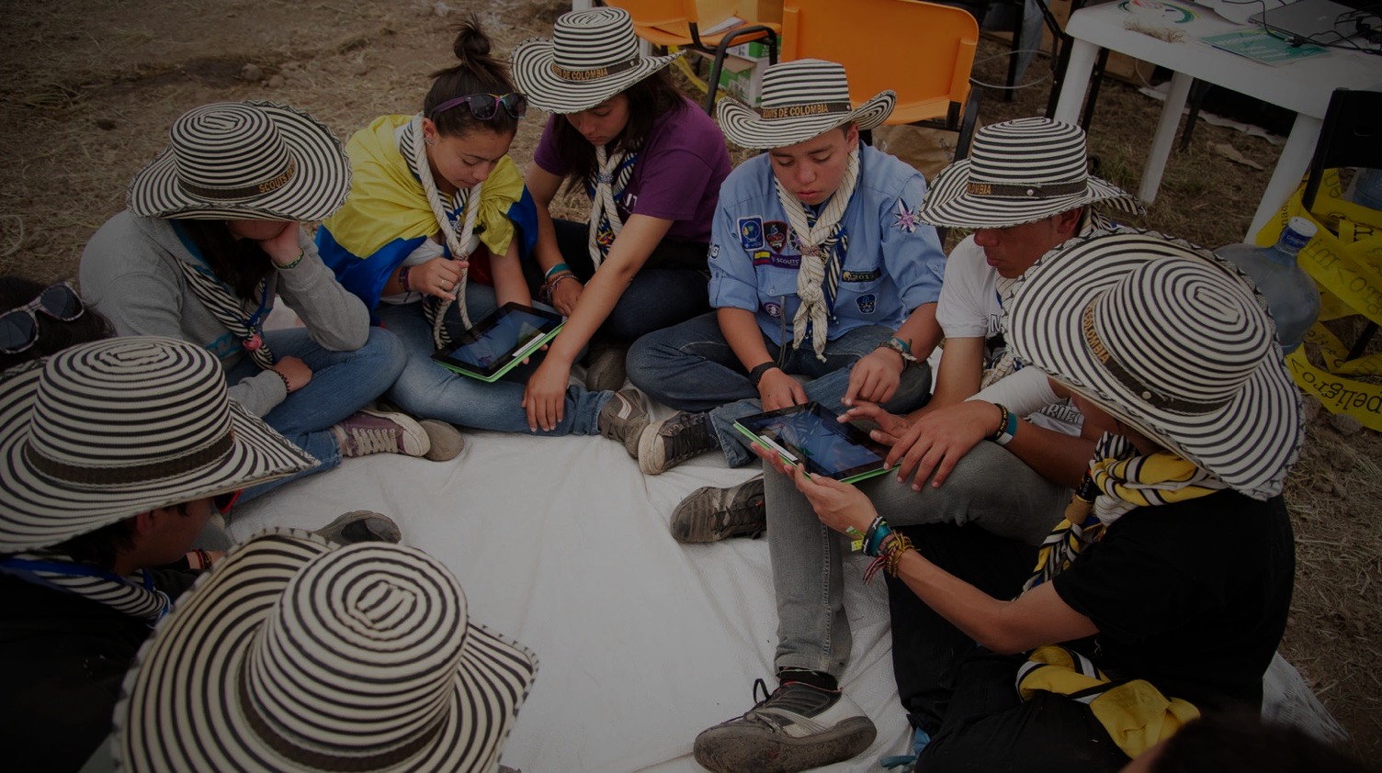

COMMUNICATIONS Thematic Team
World Scouting
Strategy on
Communication &
Strategic Engagements
COMMUNICATIONS

Slide 3
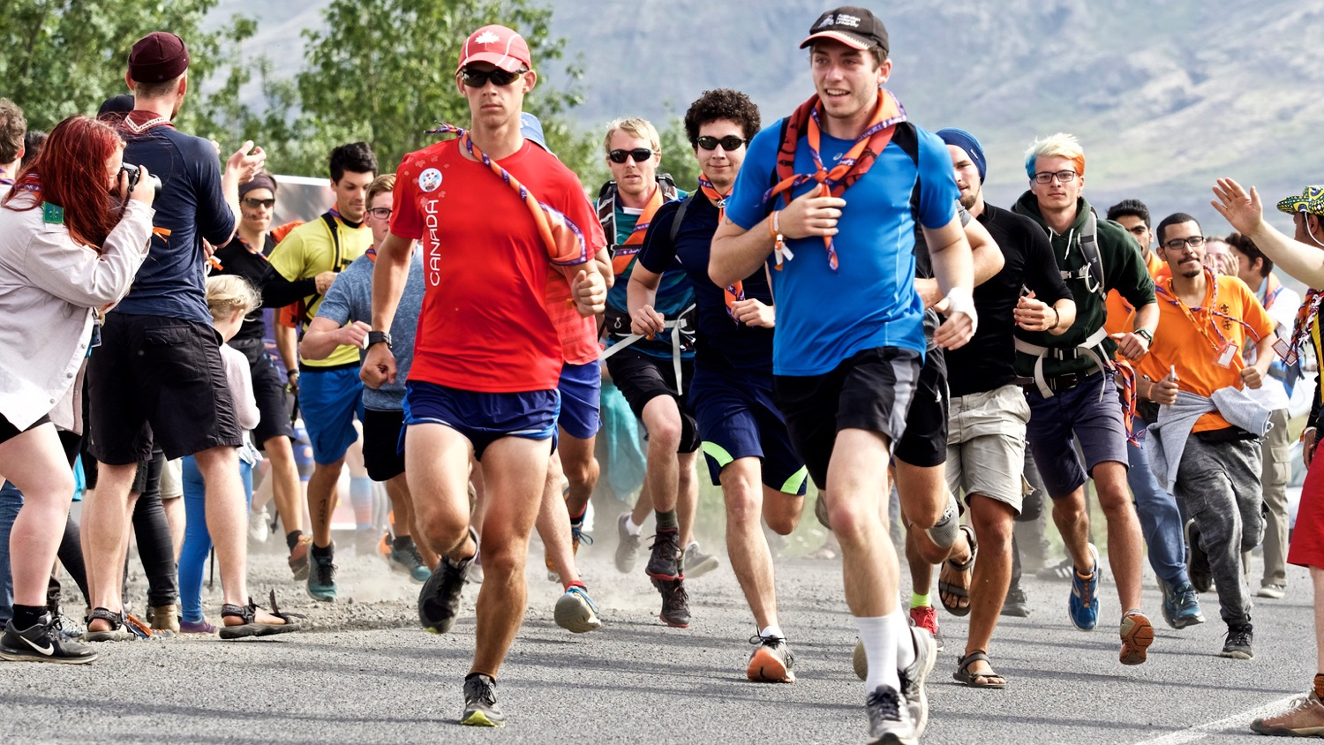
COMMUNICATIONS Thematic Team
"Strategy is not the consequence of planning, but the opposite: its starting point.”
Henry Mintzberg

Slide 4
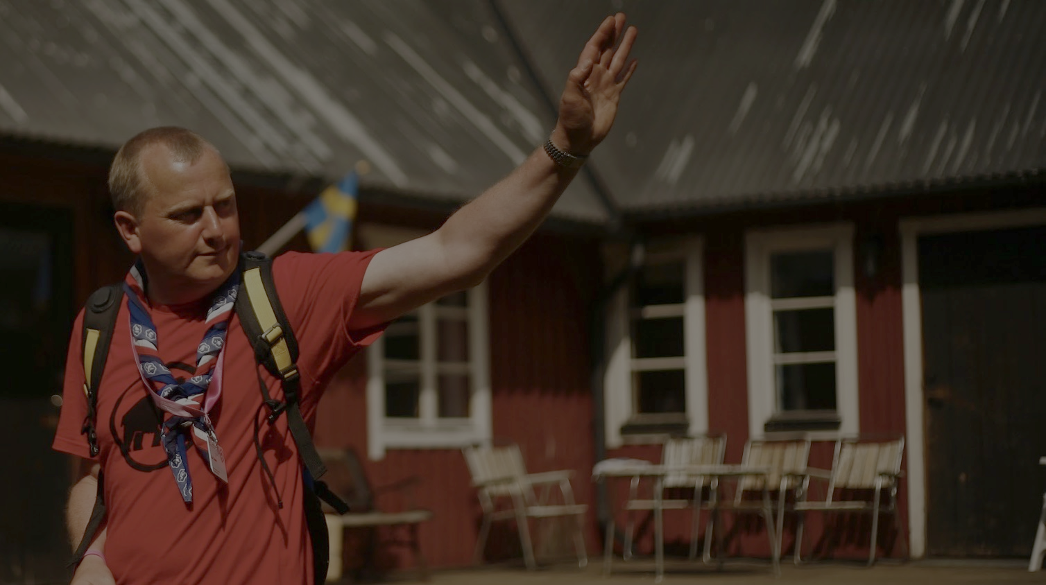
The WOSM CSE strategy aims to support the fulfilment of the Strategy for Scouting, including Vision 2023, by aligning WOSM’s CSE objectives, messages, and activities accordingly.
The CSE strategy provides a holistic framework for WOSM World and Regional bodies as well as NSOs, within which to carry out their CSE activities in a manner that is consistent (though not identical) across WOSM.
COMMUNICATIONS Thematic Team
Purpose
Notes:
The strategy document provides clarity on the priorities and purposes of WOSM (World and Regional) CSE activities. It also aims to provide a framework for NSOs on core issues such a brand, core messages and key activities that will maximise impact with limited resources.

Slide 5

COMMUNICATIONS Thematic Team
Vision for
Scouting
2023
"By 2023 Scouting will be the world’s leading educational youth movement, enabling 100 million young people to be active citizens creating positive change in their communities and in the world based on shared values."

Slide 6
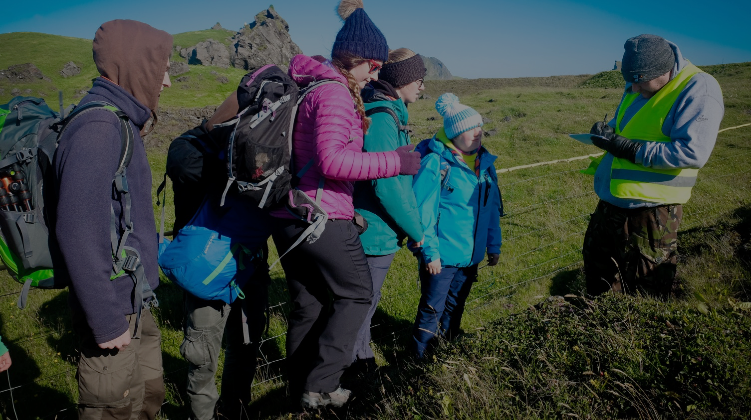
COMMUNICATIONS Thematic Team
The main focus of the CSE Strategy:
Scouting as a global Movement, rather than WOSM as an organisation.
Support National Scout Organisations to promote Scouting.
Develop and maintain Regional and global strategic partnerships.

Slide 7
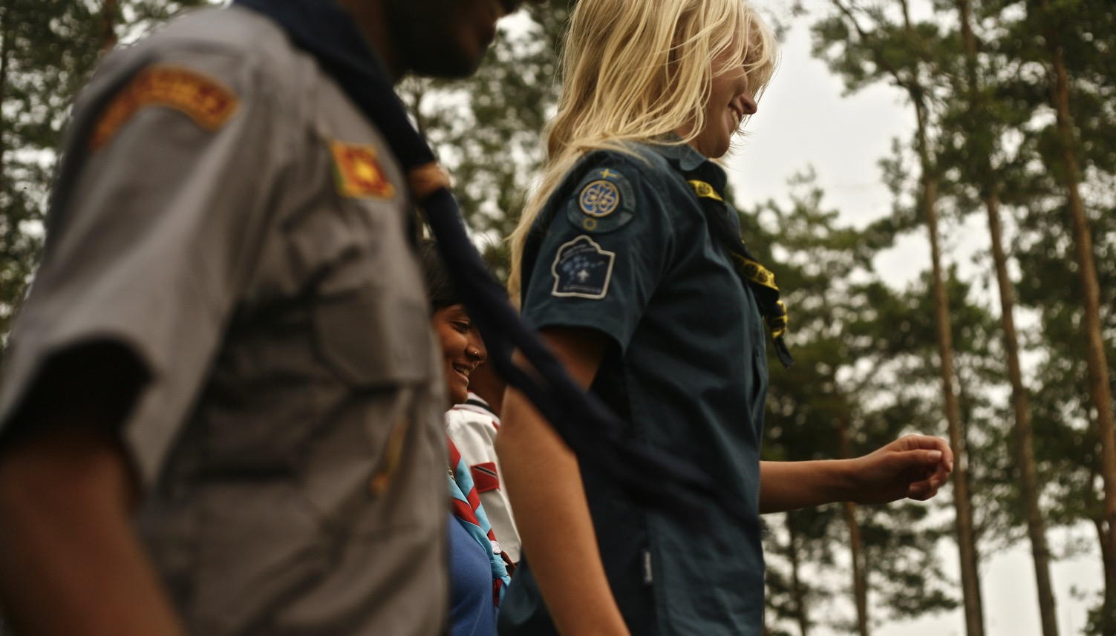
COMMUNICATIONS Thematic Team
The Impact of
The Communication
and Strategic Engagements
“world’s leading educational youth movement”
“enabling [... ] young people”
“shared values”
“100 million”
“creating positive change in their communities”
Notes:
“world’s leading educational youth movement”:
to build the recognition of Scouting among the general public and in influential external parties as the world’s leading educational movement that enables young people to meaningfully participate at the decision- making process;
• “enabling [... ] young people”:
provide platforms for young people to speak up and engage as active citizens, advocate for the importance of non-formal education and enabling young people to be active citizens;
• “shared values”:
to enable effective internal communication and dialogue that promotes shared values and the unity of the Scout Movement;
• “100 million”:
support the growth of Scouting by positively and accurately promoting Scouting and supporting and enabling NSOs to do the same;
• “creating positive change in their communities”:
bringing positive social impact and contributing to a sustainable development is the ultimate goal of all Scouting activities.

Slide 8

COMMUNICATIONS Thematic Team
Maintain a consistent brand
Collaborate
Tell stories
Implementation
of the WOSM
CSE Strategy
Notes:
1. Maintain a consistent brand
Provide training and support to all those called upon to represent WOSM both internally and externally at World and Regional levels, subject to available resources;
Directly support NSOs to enable them to comply with the WOSM CSE strategy and to achieve effective CSE actions by providing training, strategy, resources, digital assets and other support;
For external communication and strategic engagements, wherever possible, be represented by young people who are trained and supported to carry out their role.
2. Tell stories
Focus on telling Scout stories to support and amplify Scout brand values;
Use the voices and images of young people wherever possible as the primary image of WOSM;
Use user-generated content that is managed and curated to accurately present the Scout brand.
3. Collaborate
Work in partnership with NSOs and other bodies to deliver the WOSM CSE strategy;
Work in partnership with volunteers and professional staff across the CSE eld to inform, critique and assist in the further development and delivery of the WOSM CSE strategy;
Have a core team of volunteers and professional staff that will work with a wider team of trained and supported representatives who will be primarily but not exclusively young people;
Build and maintain a Global Communication Network within WOSM to ensure smooth ow of news and amplify WOSM’s messages and campaigns;
Develop a clear plan of action, including human, nancial, and technical resources required, for the short, medium, and long term, that is exible to respond to opportunities and emerging issues.

Slide 9


COMMUNICATIONS Thematic Team
Operating
Areas

Slide 10
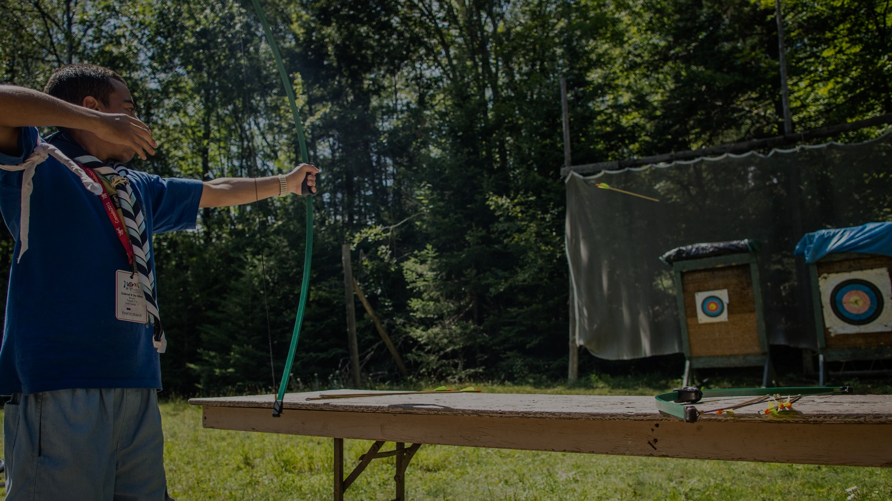
COMMUNICATIONS Thematic Team
What we offer our youth members:
A values based, non-formal education programme that enables them to develop the skills to become active citizens and create a positive change (social impact) in their communities and in the world.

Slide 11
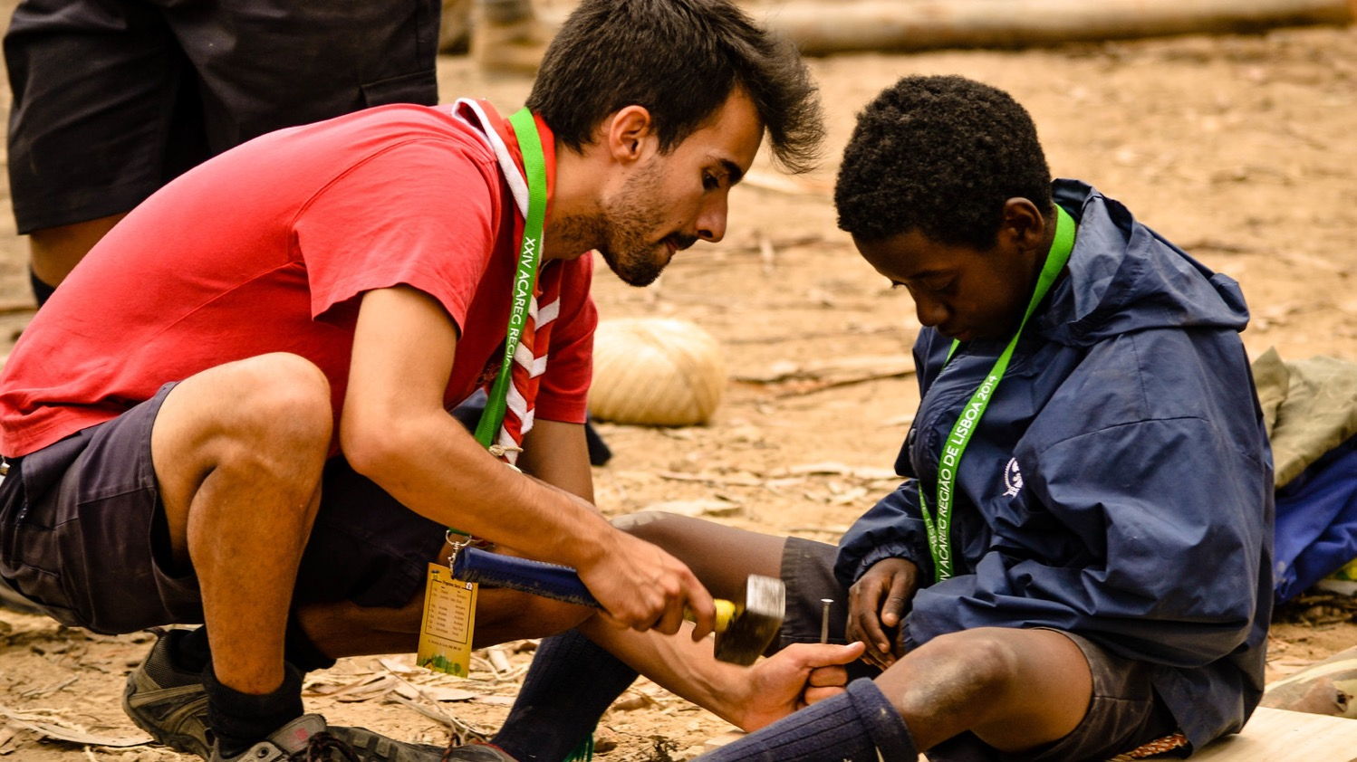
How?
We achieve this by using the Scout Method to help young people engage in a range of non-formal learning opportunities with their friends.
This includes (but not limited to)
engaging on issues that are chosen locally based on geographical and local needs and according to the needs of young people, e.g. (list in no particular order and examples only).
COMMUNICATIONS Thematic Team

Slide 12
How?
Education
Employment
Youth empowerment
Volunteering
Sustainable Development/Environment
Peace and dialogue
Emergency preparedness/ Disaster relief
Refugees
Gender
Leadership
COMMUNICATIONS Thematic Team

Slide 13
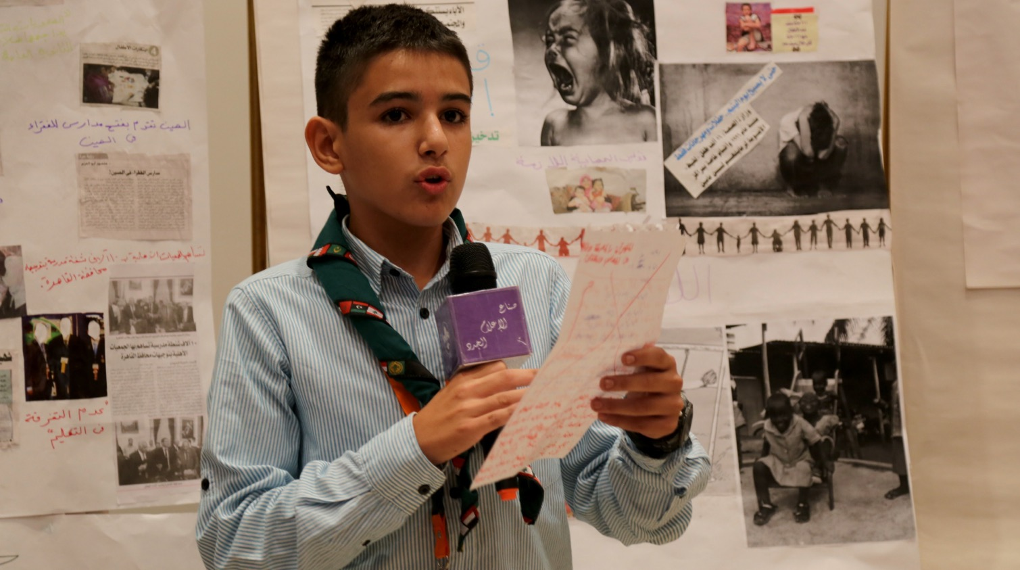
COMMUNICATIONS Thematic Team
Tone of written
or spoken word
Youthful
Challenging
Positive
Authentic
Inspiring
Confident
Engaging
Caring

Slide 14
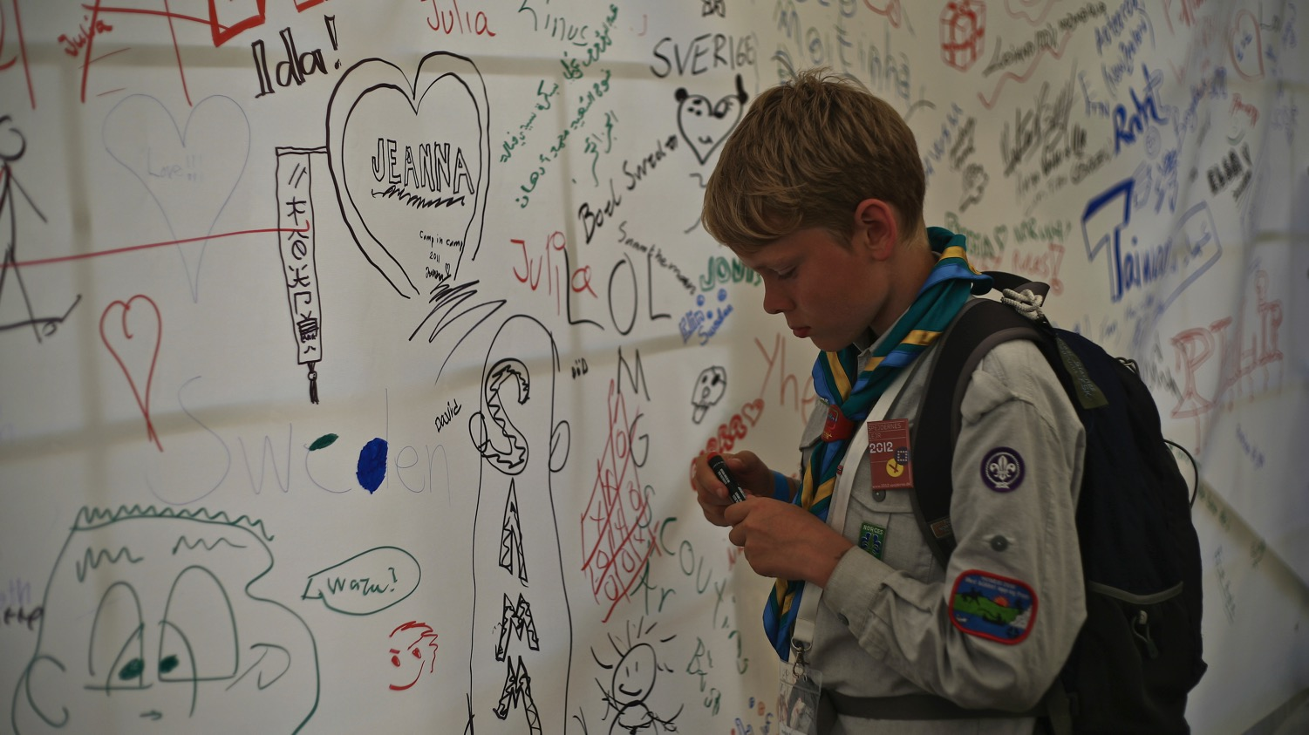
COMMUNICATIONS Thematic Team
Style of Images/Video
Youthful
Outdoors
Happy
Diverse (culture, gender, geography, religion, etc.)
In action
Entrepreneurial
Collective

Slide 15
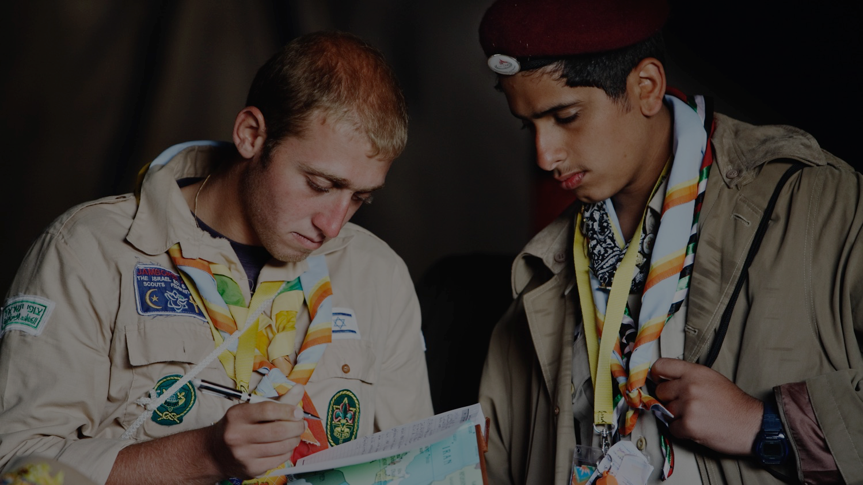
COMMUNICATIONS Thematic Team
Group Work

Slide 16
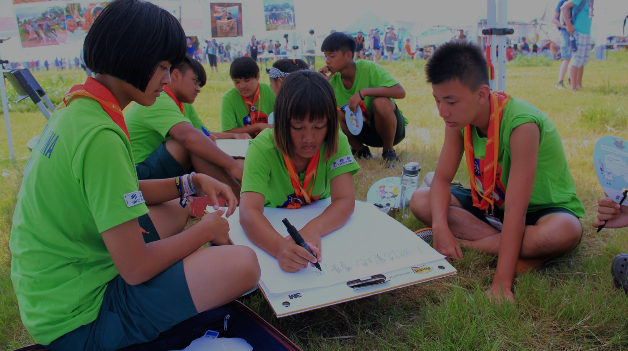
COMMUNICATIONS Thematic Team
How it would look if you would implement this now:
Make a list - Map everything you would need to change if you would have CSE Strategy adopted and aligned with World one.
How would your channels look like? Show example.
Change messaging and photo on a social media post or article from your NSO.
Exercise:

Slide 17
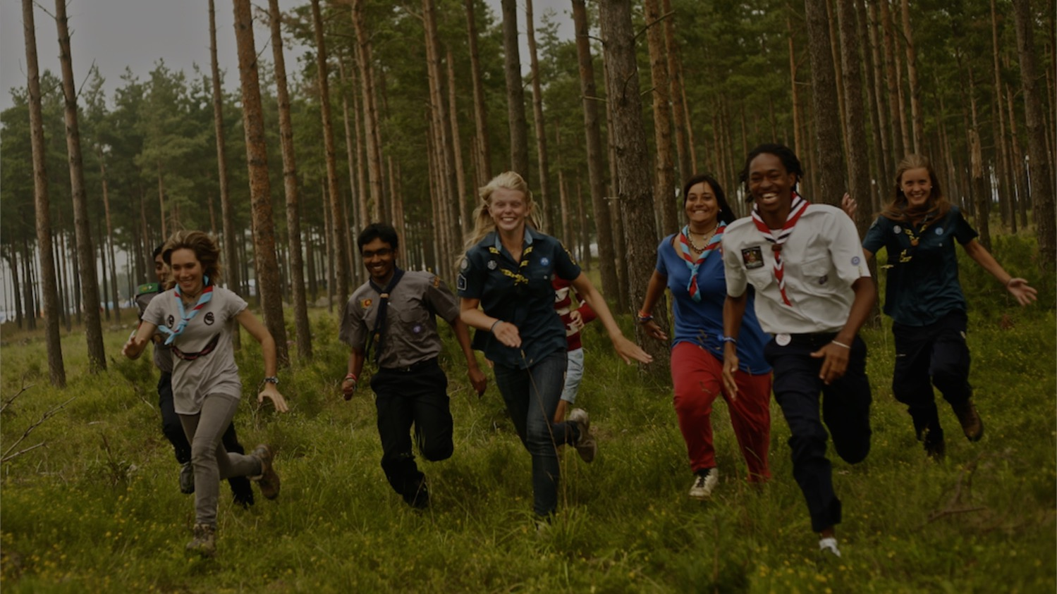
50 MILLION SCOUTS
IN OVER 220 COUNTRIES
AND TERRITORIES
ARE CREATING
A BETTER WORLD…
Thank You

Slide 18

Communications
Thematic Team
May 2018

